Slide 1
Fine Tuning Language Models for Classification
Gavin Butts, Ava Hoeger

Slide 2
TABLE OF CONTENTS
01
02
03
04
Background
Dataset
Results
Inference
What is a Language Model and how do you fine tune it?
Overview of Stanford Natural Language Inference Corpus
Results of full fine tuning and LoRA fine tuning
What good is a model if you don’t use it!

Slide 3
01
Background

Slide 4
Data Processing
What is Subword Tokenization?
Converts complex sentences into a simpler format
Words are broken into their components (prefix, suffix, etc.)

Slide 5
Data Processing
What is Subword Tokenization?
Converts complex sentences into a simpler format
Words are broken into their components (prefix, suffix, etc.)
How do Neural Networks process tokens?
Converts tokens to integers
Input integers into model

Slide 6
Language Models
What is a Language Model?
A neural network that models language
Capable of understanding relationship between words
What makes the Language Models so effective?
The building block of these models is the Transformer
Transformers models how words to depend upon other words
The cat jumped over the fence

Slide 7
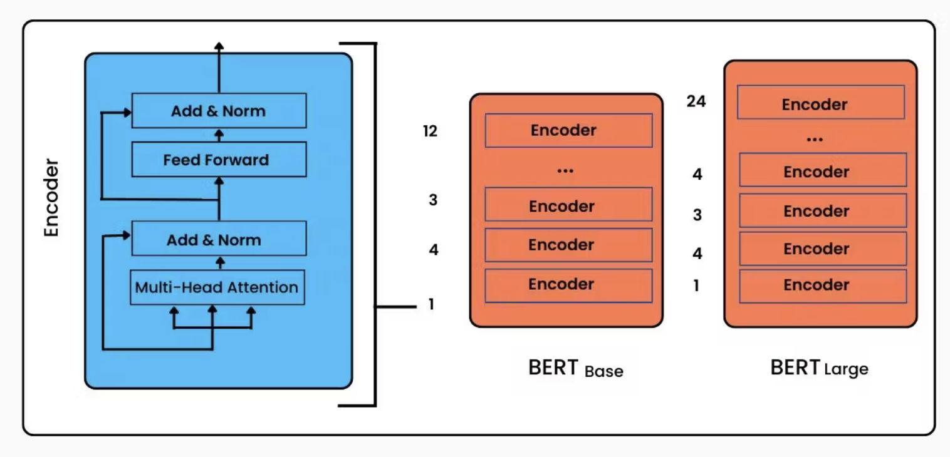

BERT Models
BERT is a specific type of language model
Bidirectional Encoder Representations from Transformers

Slide 8
RoBERTa
RoBERTa is a specific type of BERT model
Robustly optimized BERT approach
Same architecture as BERT
Trained by removing particular training steps while increasing dataset size

Slide 9
Full Fine Tuning
To Fully Fine Tune a model:
Identify what problem you hope to solve
Find an appropriate, pre-trained model
Find dataset associated with your problem
Train model with already instantiated weights

Slide 10
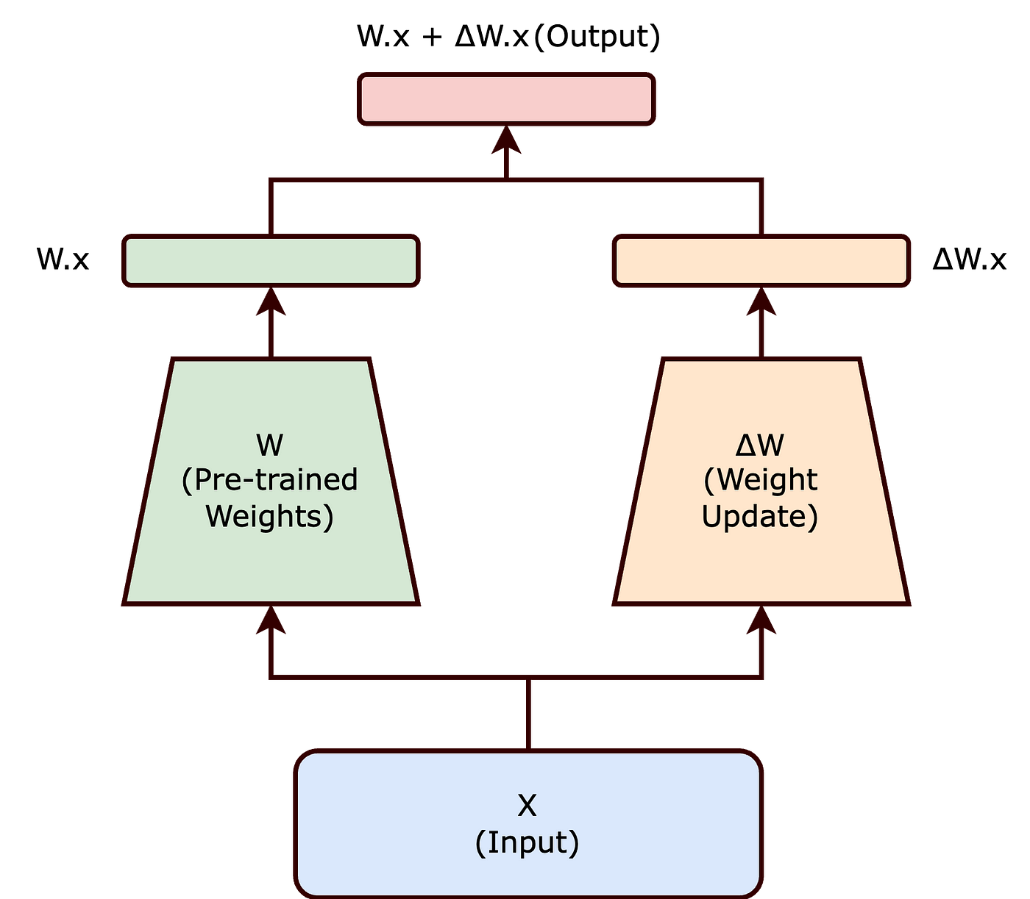
Fine Tuning via LoRA
What is LoRA
Low Rank Adaption
Finetunes Weight Update matrices
Freezes Pre-trained Weights

Slide 11
Goal
Given a pre-trained RoBERTa model, does full fine tuning or LoRA perform better on classification tasks?

Slide 12
02
Dataset

Slide 13
Stanford Natural Language Inference (NLI)
Stanford Natural Language Inference (SNLI), also known as Recognizing Textual Entailment (RTE), is the task of determining the inference relation between two (short, ordered) texts: entailment, contradiction, or neutral
570k human-written English sentence pairs manually labeled for balanced classification

Slide 14
Data Labels
For some text A and text B
Entailment: Given text A, text B is clearly true
Neutral: Given text A, text B could be true but we can’t be certain
Contradiction: Given text A, text B is definitely false
Example: Two dogs are running through a field.
Entailment: There are animals outdoors.
Neutral: Some dogs are playing fetch.
Contradiction: The dogs are sitting on a couch.

Slide 15
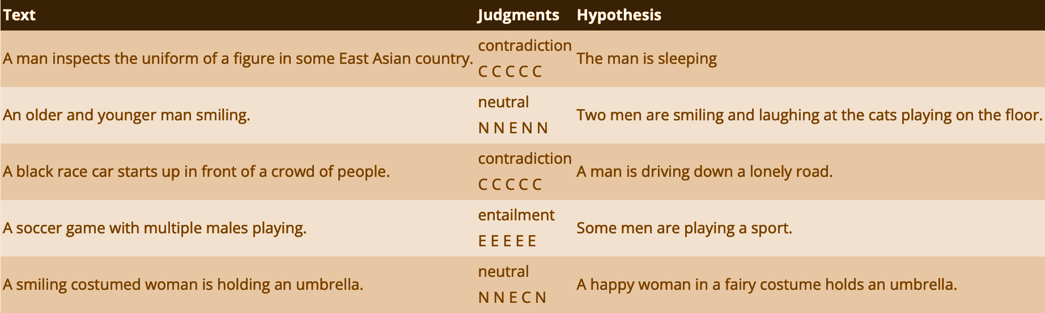
Additional Examples

Slide 16
Data Pre-Processing
Data points with low Inter-Rater Reliability removed (where labelers disagreed):
0.14% of training data points removed (785/549367)
0.18% of testing data points removed (176/9824)
Labels re-assigned:
entailment → 0
neutral → 1
contradiction → 2

Slide 17
Data Pre-Processing
Reduced size of dataset
Fine Tuning is usually used on tasks without access to large datasets
Fine Tuning is usually used because of its ability to run quickly
Data set reduced by 50% via Stratified Sampling
Samples data points with respect to class
Maintains class proportions

Slide 18
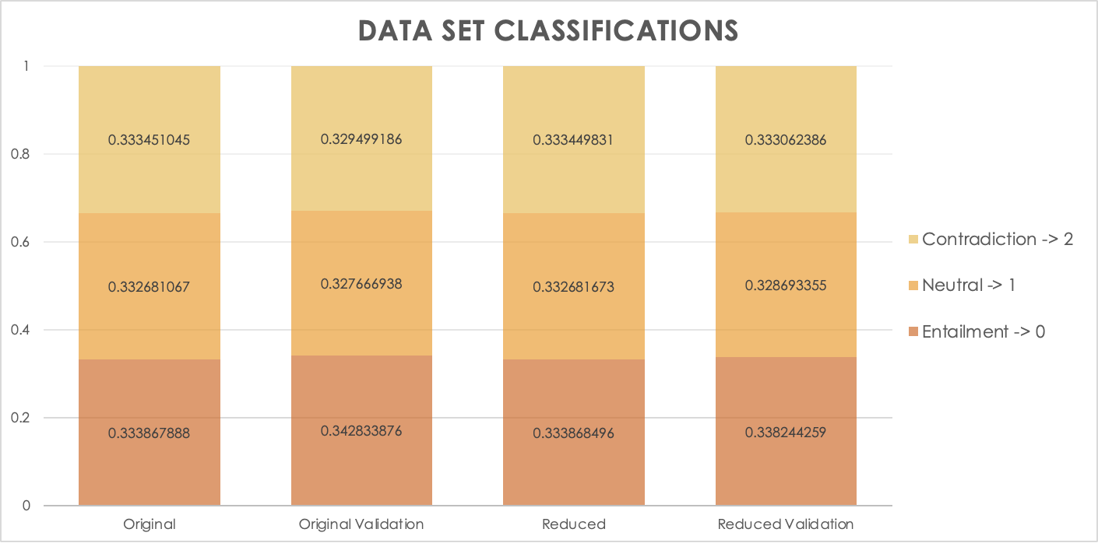
Class Balance Original vs. Reduced

Slide 19
03
Results

Slide 20
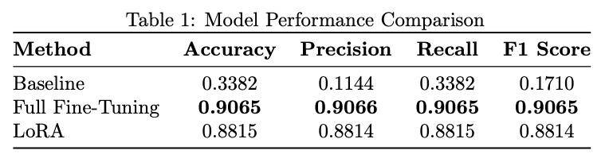
Evaluation Metrics

Slide 21
04
Inference

Slide 22
Inference Examples
On Google Colab

Slide 23
Examination of Low Inter-Rater Reliability
On Google Colab

Slide 24
Adversarial Prompting
On Google Colab

Slide 25

THANKS!
Questions?

